Slide 1
Examples
Michael Lamport Commons
C 2011 Cambridge

Slide 2
Empirical Studies
A series of empirical studies will now be introduced
These will be in the mathematical and/or scientific domains
All studies follow the same general procedure
  Devise a related series of tasks that differ only in hierarchical complexity
  Administer tasks
  Rasch analyze to see if tasks fall on one dimension
  See how well the order of hierarchical complexity predicts Rasch Scaled Stage of difficulty
How well does the order of hierarchical complexity of a task predict the stage of performance?
  The Rasch performance scores on items from each series were converted into Stage scores
The Stage scores were then regressed against the order of hierarchical complexity of each of the item from a series

Slide 3
Rasch Model
The person and item total raw scores used as dependent variables
  Sum the item raw scores separately for each order of complexity and then that could be used to correlate with hierarchical complexity
The Rasch person reliability of the combined data was .94
The Rasch item reliability was 1.0
  In the context of a Rasch analysis, this means that there is a high probability that items estimated with higher measures do in fact have higher measures than those estimated with lower measures
  There is no equivalent traditional measure

Slide 4
What Results From the Model
There are always gaps between the orders of hierarchical complexity
  It is an ordinal scale
The stage of performance is the most hierarchically complex task solved
Gaps in Rasch-Scaled Stage of Performance are predicted when
  All other sources of difficulty are controlled for
  The gaps were found to exist, ΔM_{gap} = .75, p = .009
Performance stage may be different task area to task area
  A structure of the whole is not necessary
  Horizontal decaláge for performance
  It is not inconsistency in thinking within a developmental stage.
  Decaláge is the normal or modal state of affairs

Slide 5
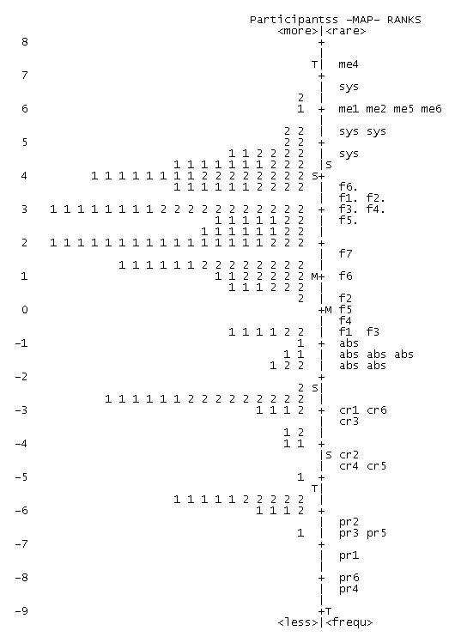
Algebra Rasch Map
Higher Stage
Participants:
223 (79.5%) men
58 (20.6%) women
Ages from 14 to 81 (M = 24.06, S.D. = 8.60)
Education varied from high school to graduate school (M = 3.85, S.D. = 1.01)
Lower Stage

Slide 6
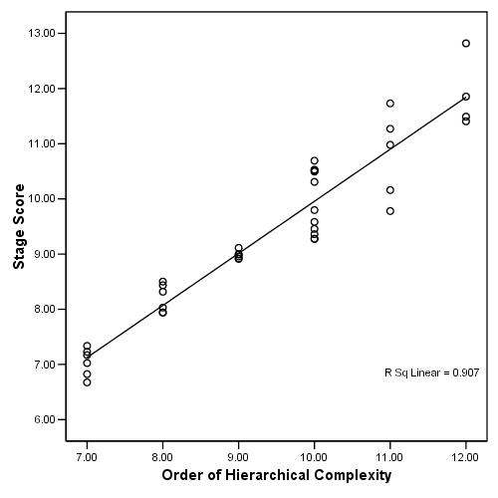
Algebra Regression
r(39) = .953**

Slide 7
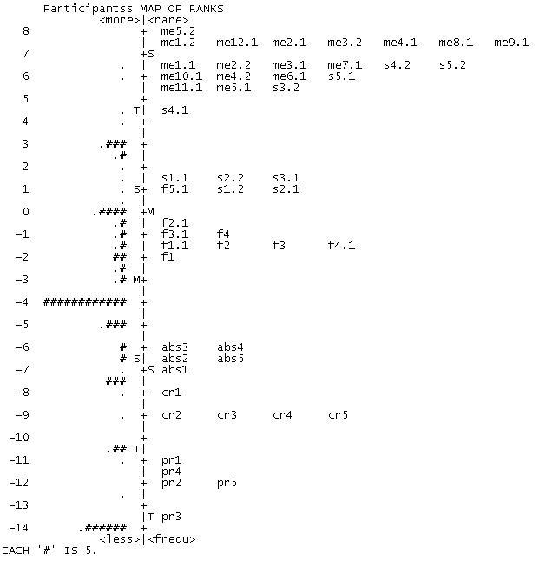
Balance Beam Rasch Map
Higher Stage
Participants:
217 (81.3%) men
50 (18.7%) women
Ages from 12 to 87 (M = 24.11, S.D. = 9.05)
Education varied from elementary school to graduate school (M = 4.01, S.D. = 1.07)
Each ‘#’ is 5 participants
Each is 1 participant
This item overlaps with the systematic order ones

Slide 8
Balance Beam Rasch Map
Higher Stage
Participants:
217 (81.3%) men
50 (18.7%) women
Ages from 12 to 87 (M = 24.11, S.D. = 9.05)
Education varied from elementary school to graduate school (M = 4.01, S.D. = 1.07)
Each ‘#’ is 5 participants
Each is 1 participant
These items overlap the metasystematic and systematic order ones
Lower Stage

Slide 9
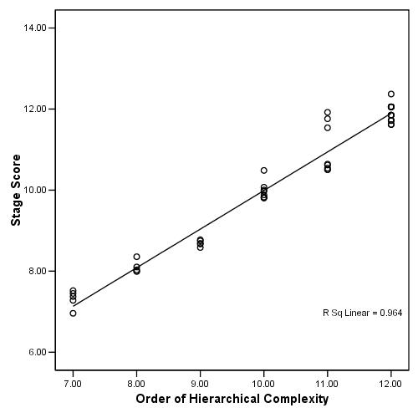
Balance Beam Regression
r(48) = .953**

Slide 10
Summary of Results
In each type of problem, the order of hierarchical complexity strongly predicted the stage of performance
There were very large regression coefficients
  .982 – Balance Beam
  .964 – Laundry
  .953 – Algebra
  .912 – Infinity
Hence, most of the variance in difficulty of tasks is due to the order of hierarchical complexity of that task

